Slide 1

Presented by
Manasa Thakkiti
Coffee Sales Analysis

Slide 2
Why Data Analysis?
Data analysis is the process of examining, cleaning, and interpreting data to discover useful insights. It helps convert raw information into meaningful knowledge that supports better decisions and understanding.
Data analysis is important because it helps identify patterns, trends, and problems that may not be visible otherwise. Businesses use data analysis to improve performance, understand customers, reduce costs, and make smarter decisions.
The process involves collecting data, cleaning errors or missing values, exploring the data using charts and statistics, and then interpreting the findings. This helps in understanding what the data is saying and what actions should be taken.
Tools like Python, SQL, Excel, Power BI, and Tableau make it easier to clean, analyze, and visualize data. They help analysts turn raw data into clear reports and visual insights

Slide 3
Coffee sales Dataset Analysis
The goal of this analysis is to study coffee sales performance based on coffe name, date, Time, Weekday and customer segment to identify sales trends and insights..
The dataset contains 3547 rows and 11 columns.
It includes 4 numerical columns such as hour_of_day,money,workdaysort,monthsort and 5 categorical columns such as coffe name,Time_of_Day,Cash_type,Weekday,Month name and 1 date column and 1 Time column.
Key Features Include:Date, Time_of_Day, Weekday, Coffee_name, Money, and Cash_type, as they help find sales trends, popular products, and customer preferences.

Slide 4
Understanding the Columns
SNO. | Column Name | Description / Purpose | Data type
1 | Date | The date when the coffee was sold | object
2 | Time | Exact time of the transaction | object
3 | Hour_of_Day | Hour extracted from the time (used to find peak sales hour | float64
4 | Time_of_Day | Period of the day (Morning, Afternoon, Evening, etc.) | object
5 | Weekday | Day name of the week (e.g., Monday, Tuesday) | object
6 | Weekdaysort | Numeric order of the weekday (helps in sorting days) | float64
7 | Month_name | Name of the month when the sale occurred | object
8 | Monthsort | Numeric order of the month (helps in sorting months) | float64
9 | Coffee_name | Type or name of coffee sold | object
10 | Cash_type | Payment method used (e.g., Cash, Card, Online) | object
11 | Money | Amount earned from each transaction | float64

Slide 5
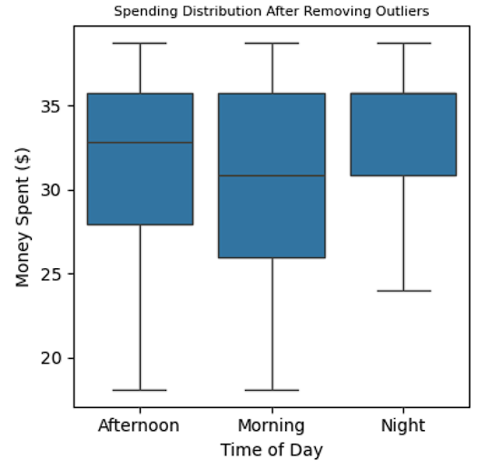
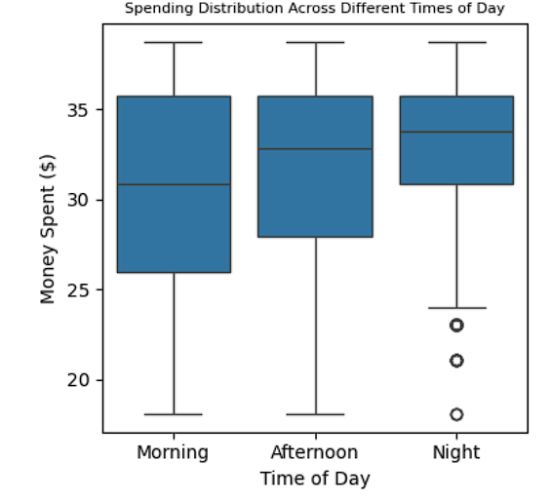
Handling Outliers
Outliers are data points that lie far away from most other values.
In coffee sales, they represent unusually high or low spending compared to the typical customer behavior.
  The box plot for Money Spent ($) shows some outlier points (circles), especially in the Night category.
  These indicate that a few customers spent much less than the usual spending range at night.
  Morning and Afternoon times have more consistent spending (no visible outliers).
  Outliers can mislead the mean, making results appear higher or lower than reality.
  Removing outliers helps in getting accurate, balanced, and trust and meaningful insights.

Slide 6
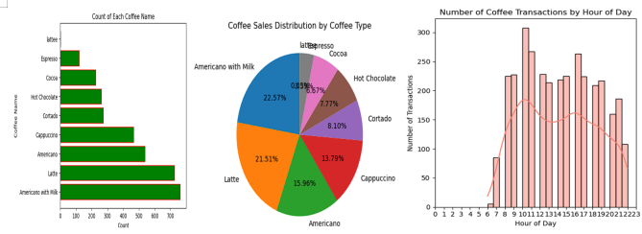
Univariate Analysis
Univariate analysis means analyzing one variable (or column) at a time to understand its pattern, distribution, or frequency.
The analysis shows that Americano with Milk and Latte are the most popular coffee types among customers.
Sales transactions peak between 9 AM and 12 PM, indicating that most coffee purchases occur during the Morning hours are the busiest for sales .

Slide 7
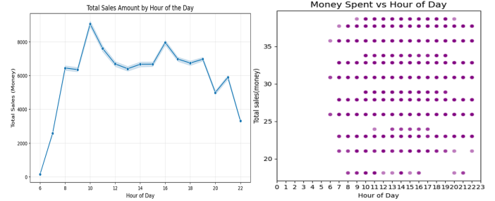
Bivariate Analysis
Bivariate analysis means studying the relationship between two variables to understand how one affects the other.
1. Numerical vs Numerical:
The analysis shows that total sales peak between 9 AM and 11 AM, with another rise around 3 PM to 5 PM. This indicates that most customers purchase coffee during morning and afternoon hours, making these the most profitable times of the day..

Slide 8
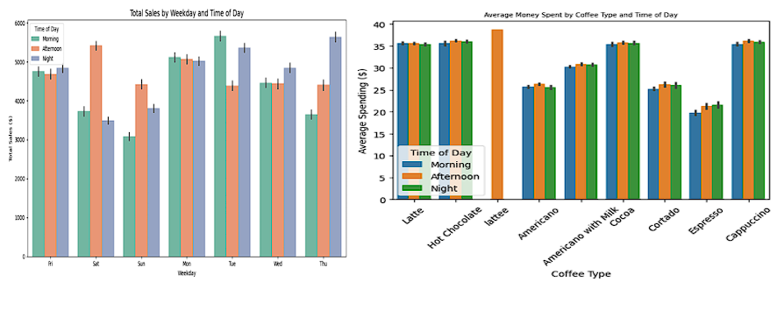
2. Categorical vs Categorical
Sales are highest on Monday, Thursday, and Friday.and Lowest sales occur on Sunday.
Morning and Afternoon are the busiest times for coffee purchases.
Indicates strong demand from working professionals during weekdays.
Latte, Cappuccino, and Americano with Milk have the highest average spending.
Spending is slightly higher in the morning, showing premium choices early in the day.
Cortado and Espresso show lower spending, likely due to smaller sizes or prices.
Overall spending remains consistent throughout the day.

Slide 9
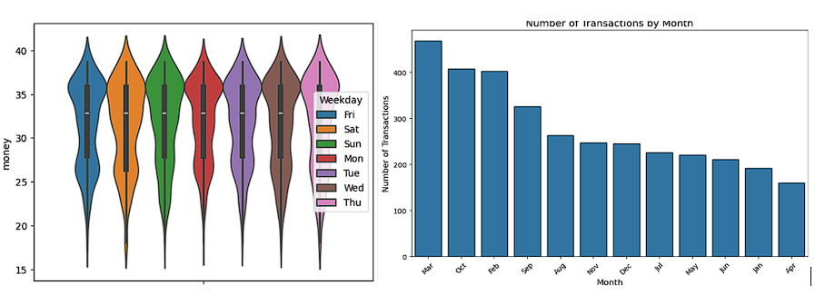
3. Numerical vs Categorical:
Spending is consistent across all weekdays.
Average spend: ₹30–₹35..
Weekends (Saturday and Sunday) show a wider spending range, indicating some customers spend significantly more or less.
March records the highest number of transactions, followed by October and February, indicating peak activity during these months.
After March, there is a gradual decline, with April showing the lowest number of transactions.
Overall, the trend shows that sales may change from month to month due to seasonal demand or customer buying patterns.

Slide 10
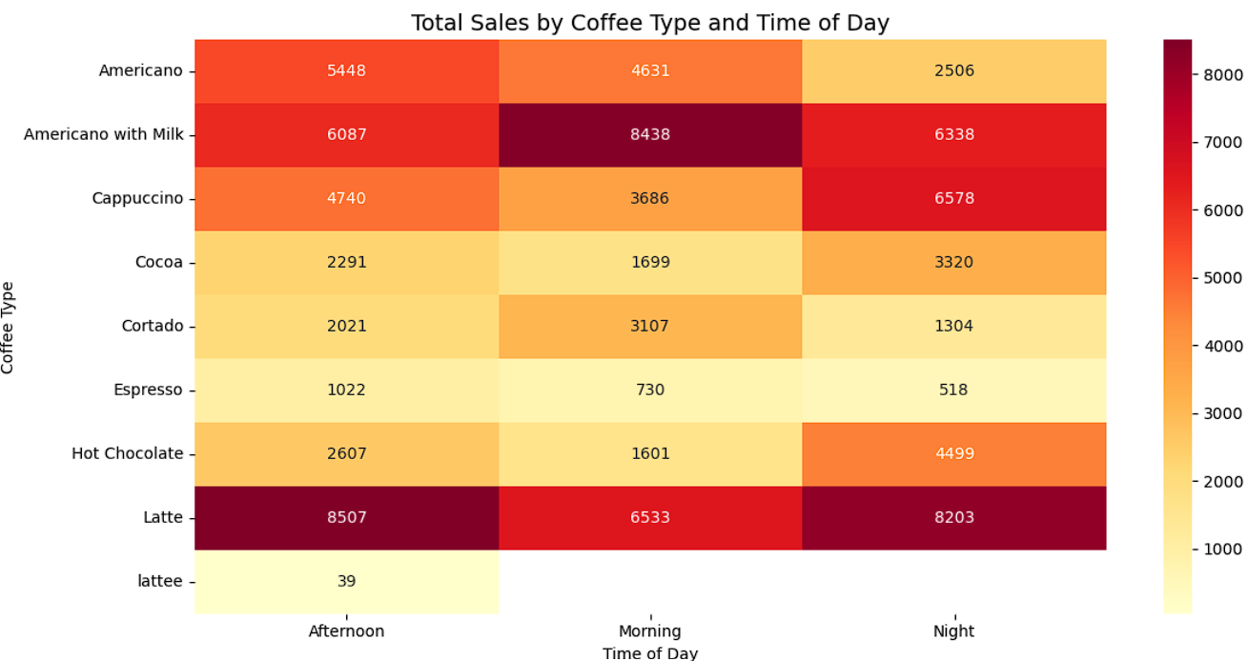
Multivariate Analysis
Multivariate analysis explores relationships among three or more variables simultaneously.
Latte and Americano with Milk are the top-selling coffee types throughout all times of the day.
Espresso and Cortado show the lowest sales, indicating a smaller customer base for strong, plain coffee.

Slide 11
Insights
Peak Hours: 9 AM–12 PM & 3 PM–5 PM — busiest and most profitable times.
Top Days: Monday, Thursday, and Friday show the highest sales; Sunday the lowest.
Indicates strong weekday demand from working professionals.
Average spend: ₹30–₹35 across all weekdays.
Weekends show slightly higher variation in spending.
Latte, Cappuccino, and Americano with Milk attract higher spending.
Cortado and Espresso have lower spending due to smaller sizes or prices.
Outliers mainly during night hours, where customers spent unusually less.
Removing outliers ensures accurate, balanced, and trustworthy insights.
March records the highest transactions, followed by October and February.
April has the lowest sales, indicating seasonal buying patterns.

Slide 12
Conclusion
Morning and Afternoon are the most profitable times, showing that customers prefer coffee during work hours or breaks.
Weekdays outperform weekends, highlighting office-going customers as the primary buyers.
Latte and Americano with Milk are the top-selling beverages, reflecting a preference for premium and milk-based coffees.
Consistent average spending (₹30–₹35) indicates stable pricing and loyal customer behavior.
Outlier removal improved data accuracy and helped uncover genuine spending trends.
Weekend variations show more casual or mixed spending habits — possibly families or leisure buyers.
Monthly trends suggest seasonal demand, with March showing a peak — likely due to festive or cooler-season consumption.
Card payments dominate, showing customers’ preference for digital and cashless transactions.
The analysis helps identify when and what to promote, supporting inventory planning and marketing strategies.
Overall, the café achieves steady sales performance with potential to boost off-peak hours through targeted offers or promotions.

Slide 13
Future Scope:
Suggest coffee types to customers based on past purchase behavior
Promote popular drinks like Latte and Americano with Milk through combo offers.
Analyze data to decide optimal pricing, discount timing, and inventory management.
Combine reviews or ratings with sales data to understand satisfaction and preferences.
Develop a mobile ordering or delivery platform to reach more customers and increase convenience.
Use sales insights to stock high-demand products and reduce waste from slow-moving items.
Launch a loyalty app or card system to reward repeat buyers and increase purchase frequency.
Introduce new flavors, snacks, or seasonal beverages to attract different customer groups.
Adjust prices based on time of day or season (e.g., premium pricing in peak hours, discounts off-peak).
The future scope of this coffee sales analysis is to develop interactive dashboards, apply predictive analytics.

Slide 14

THANK YOU

